Slide 1

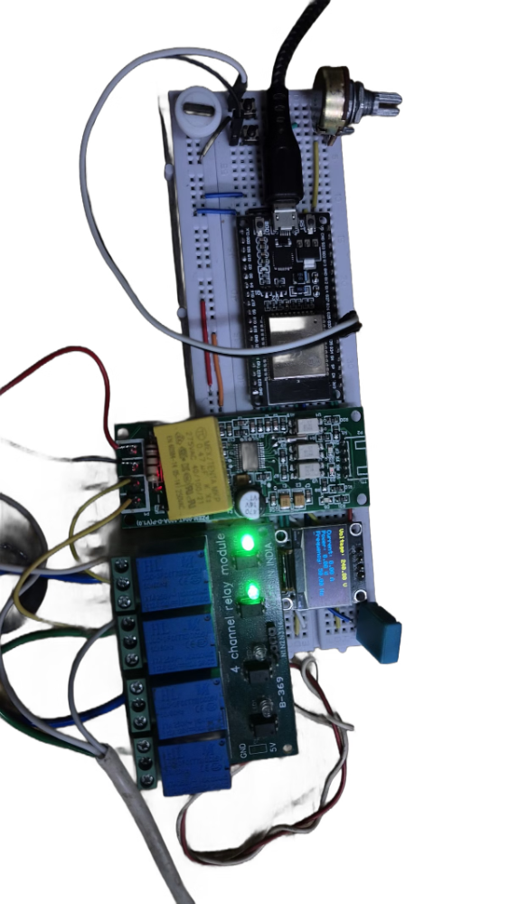
Smart Energy Meter: Real-Time Monitoring & Control
Power management for a smarter future.
Notes:
1

Slide 2
Introduction to the Smart Energy Meter
A smart energy meter is a digital device that measures and records electricity consumption data in real-time. It provides valuable insights into energy usage patterns, empowering users to manage their energy more efficiently.
The primary objective of this project is to develop a "device that monitors, protects, and manages energy effectively" - a crucial tool for modern energy systems that demand increased sustainability and optimization.
Notes:
2

Slide 3
Introduction to the Smart Energy Meter
Rising Demand for Smarter Energy Systems: The growing need for efficient and sustainable energy management drives the development of advanced metering solutions.
Limitations of Traditional Meters: Conventional energy meters lack real-time monitoring capabilities and fail to provide comprehensive fault protection, limiting their effectiveness in modern energy grids.
Objectives: The project aims to deliver a smart energy meter that offers real-time energy monitoring, fault detection and alerts, and cloud-based data analytics for improved energy management.
Notes:
3

Slide 4
Literature Review on Smart Energy Meters
Traditional Meters
1
Traditional energy meters have limited functionality, relying on manual readings and lacking real-time data monitoring capabilities.
IoT-Based Solutions
2
Advanced smart meter designs leverage IoT technologies, integrating various sensors and enabling cloud-based data analytics.
Identified Gaps
3
Despite progress, there is still a need for more comprehensive smart meter features, including advanced fault detection and deeper data integration.
Notes:
4

Slide 5
Key Features of the Smart Energy Meter
Line Switching
Real-Time Monitoring
Automatically switches between the main power line and a backup line to ensure continuous electricity supply.
Provides accurate readings of current, voltage, and power consumption in real-time to enable better energy management.
Protection Features
Cloud Connectivity
Safeguards against overloads and overvoltage to prevent damage to connected devices and ensure safety.
Allows for remote data logging and analysis through seamless integration with cloud-based platforms.
Notes:
5

Slide 6
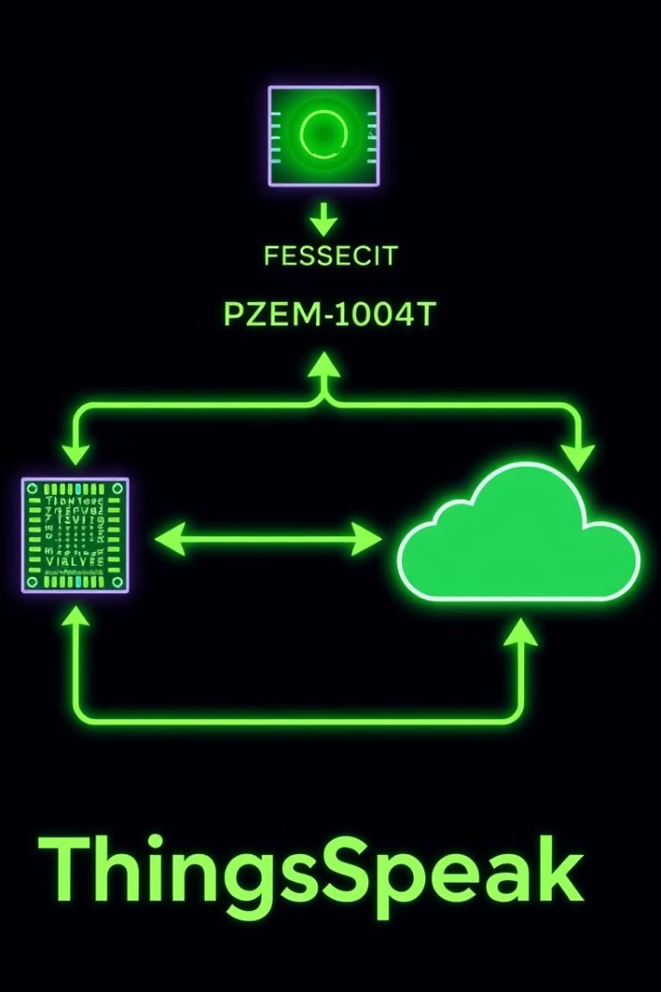





Technical Design & Coding Flow
PZEM-004T Data
Voltage, current readings.
ESP32 Processing
Data interpretation and control logic.
ThingSpeak Integration
Cloud data storage and visualization.
Relay Control
Power switching based on thresholds.
Custom Dashboard
Data visualization and Power switching controls
Notes:
6

Slide 7
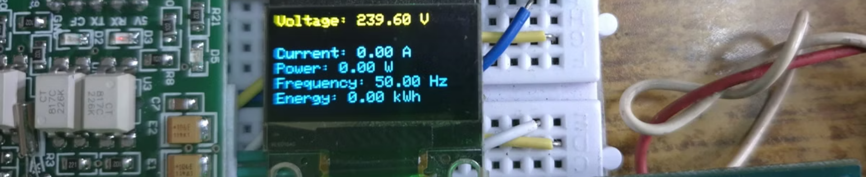
Hardware Components
PZEM-004T
Voltage & current monitoring
ESP32
WiFi connectivity & control
OLED Display
Real-time data display
Relay Modules
Power switching functionality
Notes:
7

Slide 8




Smart Energy Meter: Coding Flow
Data Acquisition
The PZEM-004T module collects real-time data on voltage, current, and power consumption.
Data Processing
The ESP32 microcontroller interprets the sensor data and executes the control logic.
Cloud Integration
The energy data is securely transmitted to the ThingSpeak IoT platform for storage and analysis.
User Interface
The OLED display presents real-time energy metrics and allows for remote power switching.
Notes:
8

Slide 9
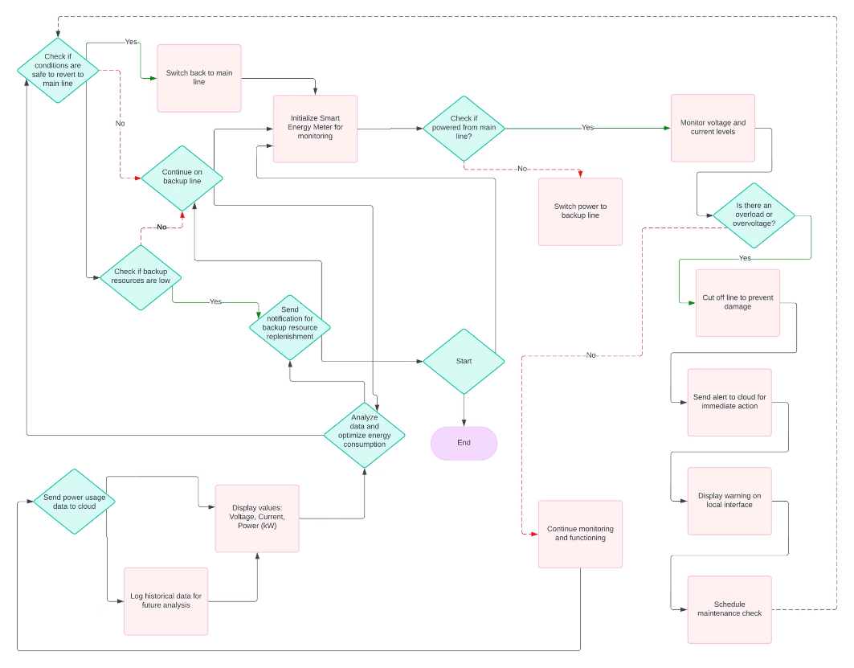
Notes:
9

Slide 10
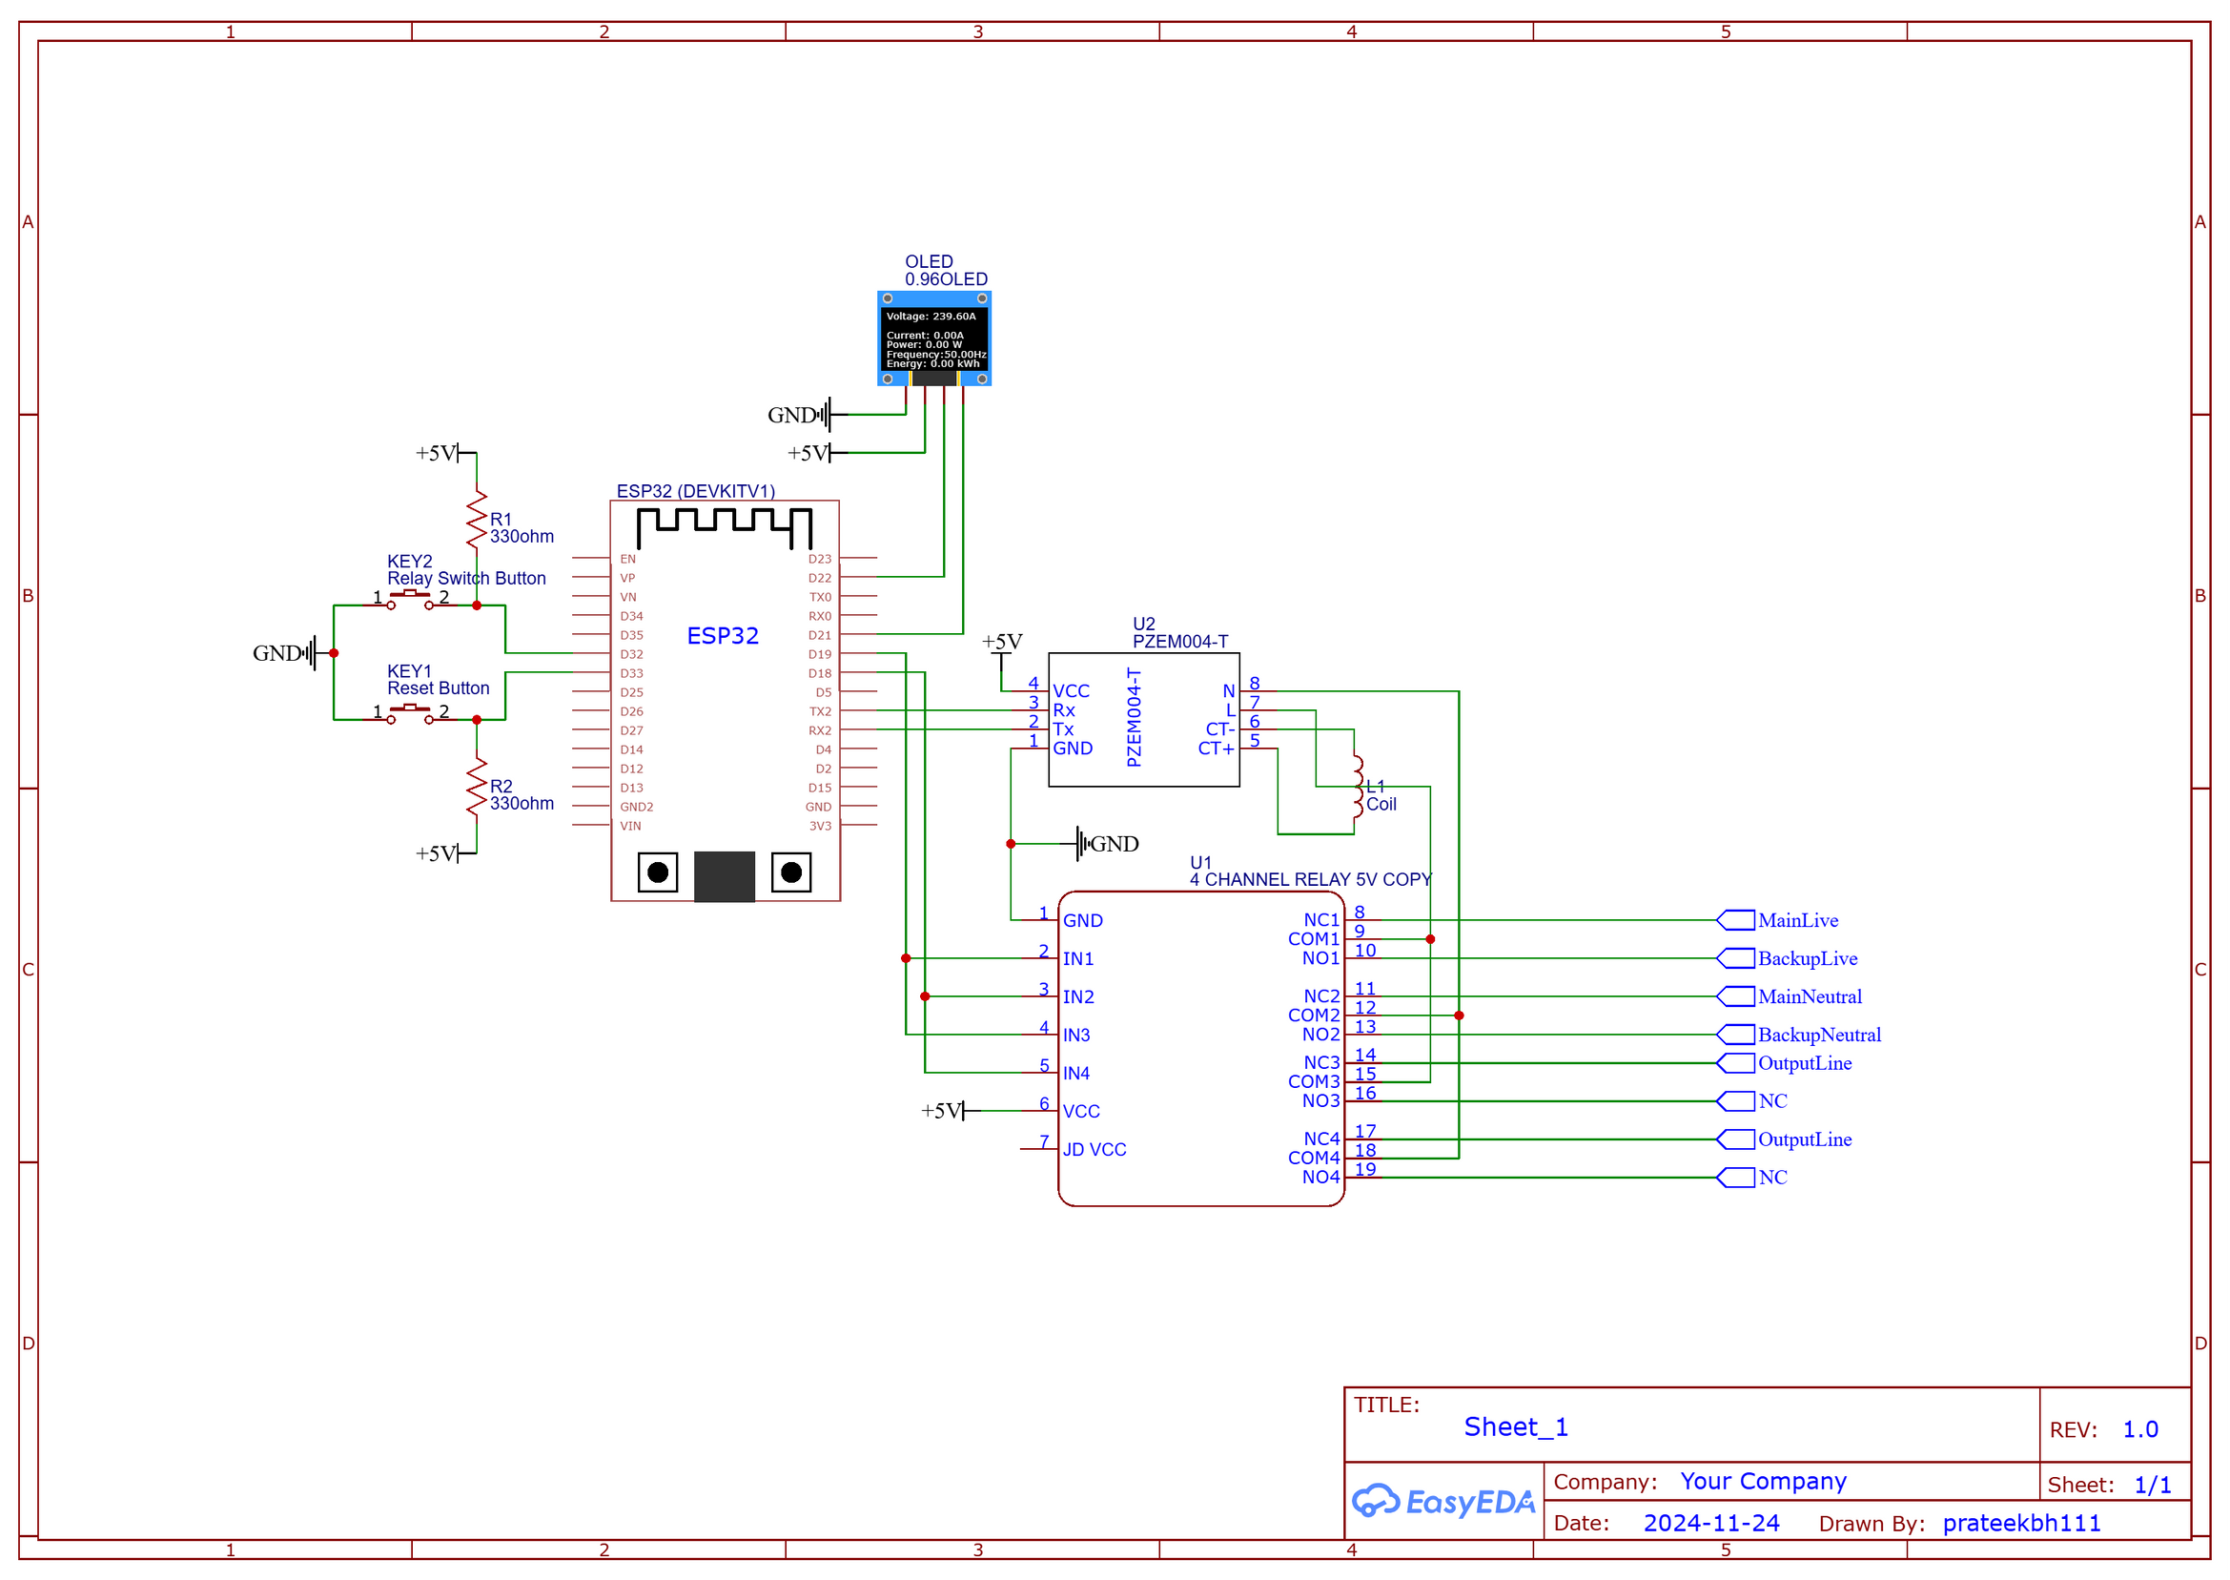
Notes:
9

Slide 11
Library Used
#include <WiFi.h>
#include "ThingSpeak.h"
#include <Wire.h>
#include "DHT.h"
#include <Adafruit_GFX.h>
#include <Adafruit_SSD1306.h>
#include <PZEM004Tv30.h>
Notes:
10

Slide 12
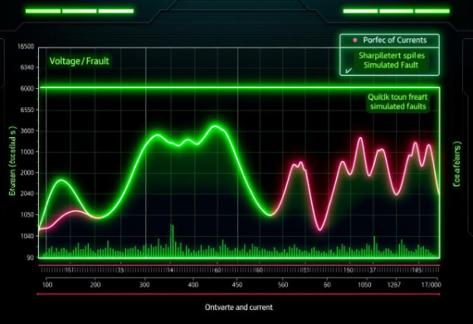
Testing and Performance Evaluation
Accurate Readings
Reliable Fault Detection
Responsive Performance
The smart energy meter demonstrated highly accurate voltage, current, and power consumption readings, with an error of less than ±2%.
The meter successfully identified and alerted users to various fault conditions, including overloads and overvoltage, ensuring the safety of connected devices.
The system exhibited a rapid response time of under 1 second, enabling real-time monitoring and control capabilities.
Notes:
11

Slide 13
Advantages of Using the Smart Energy Meter
Improved Energy Efficiency
1
The real-time monitoring capabilities of the smart meter allow users to identify and address energy waste, leading to significant savings on utility bills.
2
Real-Time Monitoring and Alerts
The meter constantly tracks power usage and can instantly notify users of spikes or irregularities, enabling quick intervention to prevent issues.
Enhanced Safety from Overloads
3
The smart meter's integrated overload protection automatically disconnects the power supply when usage exceeds safe thresholds, preventing damage to appliances and electrical systems.
4
Cloud-Based Analytics for Insights
By integrating the smart meter with a cloud platform, users can access sophisticated data analysis and visualizations to gain deeper insights into their energy consumption patterns.
Notes:
12

Slide 14
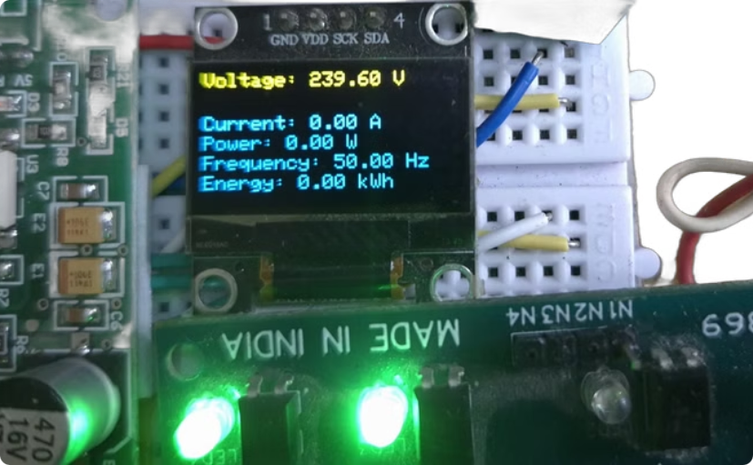
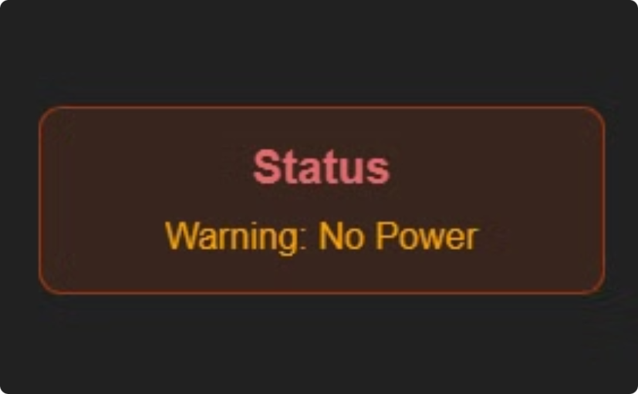
User Interface on OLED Display
Data Display
Error Messages
Voltage, current, power, frequency, and energy usage.
Warning notifications during error conditions.
Notes:
13

Slide 15
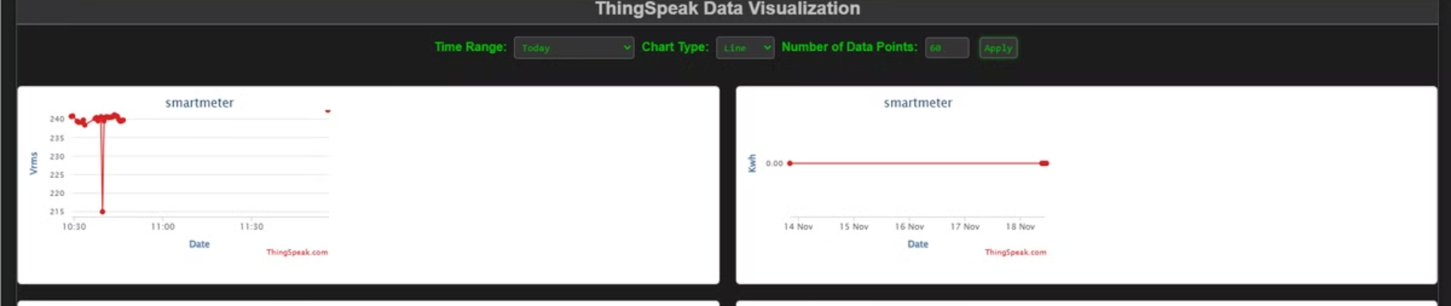



ThingSpeak Integration
Real-Time Data
Remote Monitoring
Remote Control
Voltage, current, power, and error codes.
Manage power line switching from anywhere.
Access data and visualize trends over time.
Notes:
14

Slide 16
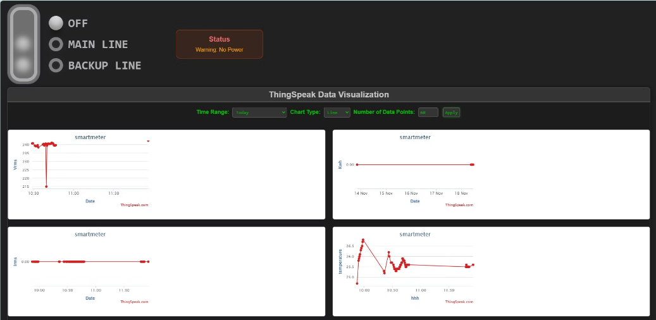
User Dashboard Based on ThingSpeak
Comprehensive Energy Analytics
Remote Power Management
The user dashboard on ThingSpeak provides real-time insights into energy consumption patterns, allowing homeowners to monitor and optimize their usage.
Users can remotely control and switch on/off power lines through the cloud-connected dashboard, enabling convenient energy management from anywhere.
Notes:
15

Slide 17
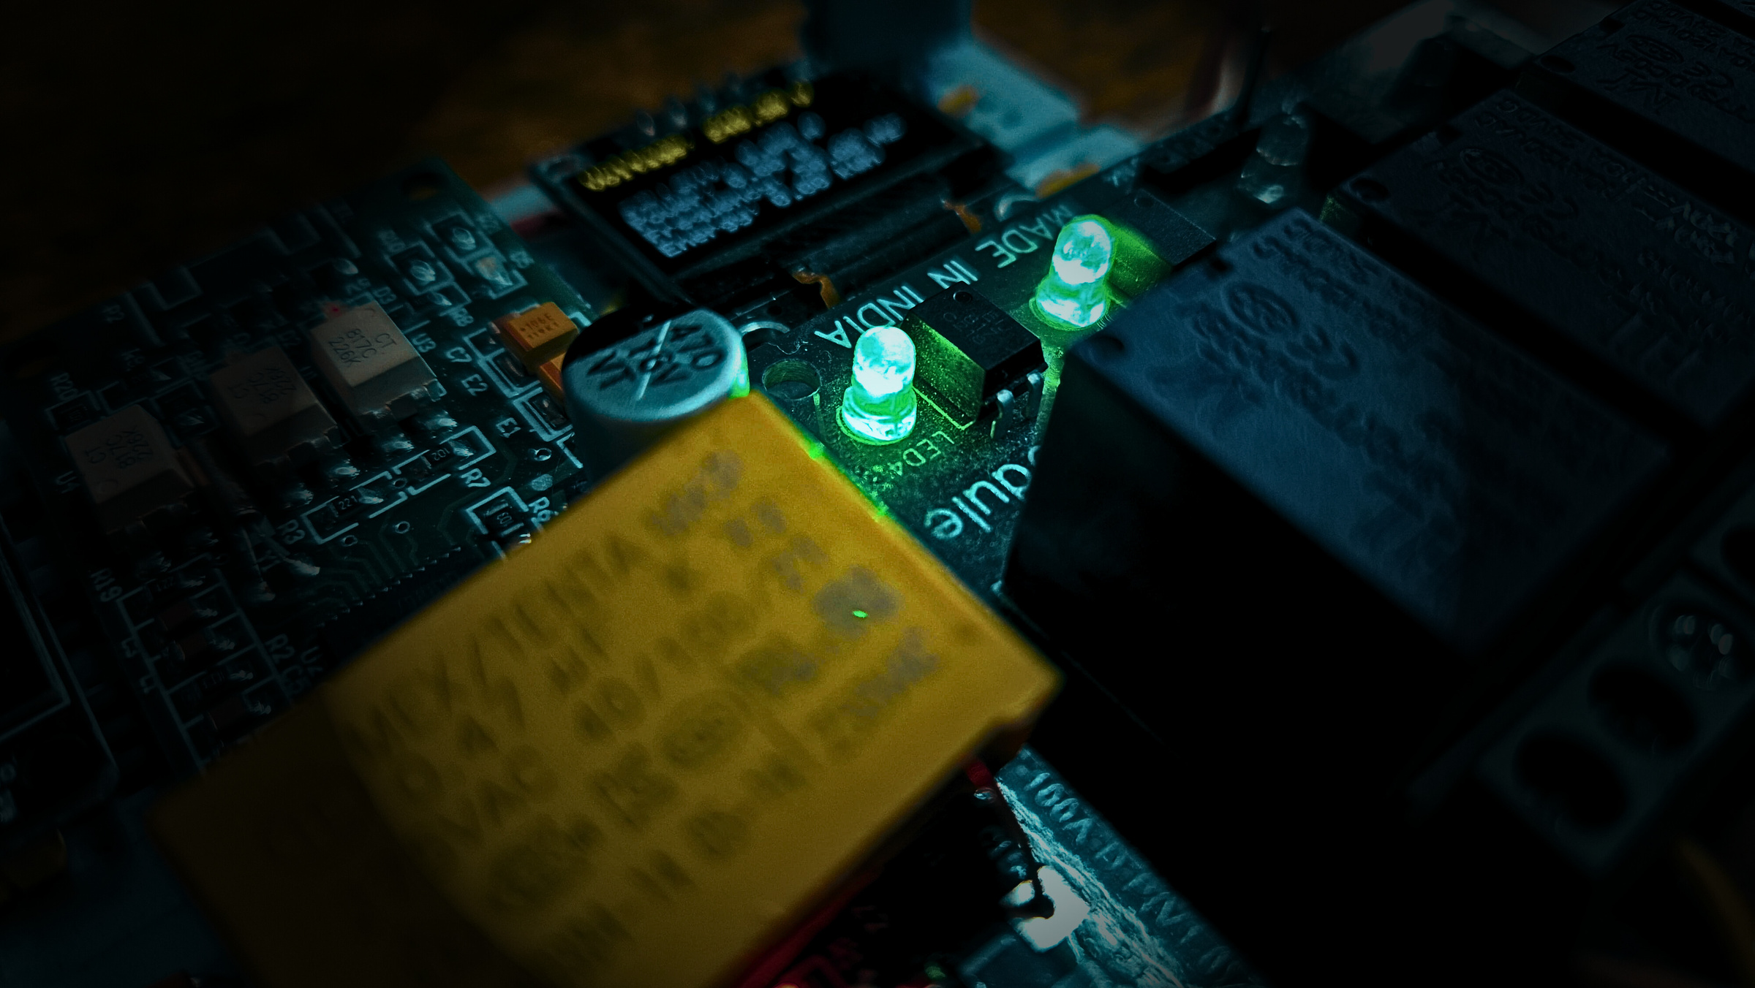
Safety Features & Error Detection
1
High Short-Circuit Detection
Error code 9 for short circuit events.
2
Relay Shutoff
Disconnects power to prevent damage.
3
Manual Reset Button
Allows user to reset the system after an error.
4
OLED Display Warning
Displays error code and prompts user to reset.
Notes:
16

Slide 18
Applications of the Smart Energy Meter
Home Energy Optimization: Track and manage energy usage in real-time to optimize household consumption and reduce utility bills.
Commercial Building Management: Provide detailed insights on energy use patterns to identify inefficiencies and opportunities for savings.
Utility Grid Monitoring: Collect granular data to help utilities better forecast demand, identify outages, and manage the grid more efficiently.
Electric Vehicle Charging: Monitor and control the charging process to avoid overloads and optimize the use of renewable energy sources.
Renewable Energy Integration: Seamlessly integrate with solar panels, wind turbines, and other distributed energy resources to enable smart energy management.
Notes:
17

Slide 19
Project Challenges
Voltage Fluctuations: Addressed by incorporating dynamic voltage regulation to ensure stable power supply.
Cloud Connectivity: Implemented redundant WiFi and Ethernet options to maintain reliable ThingSpeak integration.
Error Reset: Integrated a manual reset button and automatic error detection to quickly recover from issues.
Safety Hazards: Designed robust overload protection and automatic power shutoff to prevent device damage.
User Experience: Optimized the OLED display interface for intuitive monitoring and control.
Notes:
18

Slide 20
Testing and Performance Evaluation
Load Testing: The system was subjected to overload conditions by simulating high-power consumption scenarios. The overload protection mechanism successfully triggered the power shutoff, preventing potential device damage.
Energy Monitoring: Comprehensive power consumption tracking allowed the identification of inefficient usage patterns. The data displayed on the OLED and uploaded to ThingSpeak enabled informed decisions for optimizing energy usage.
Notes:
19

Slide 21
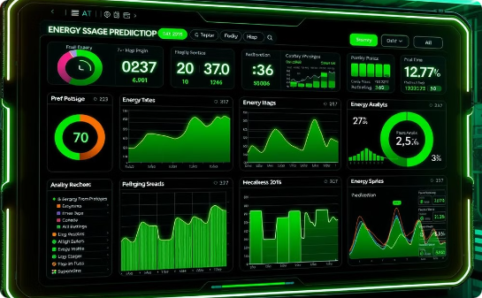
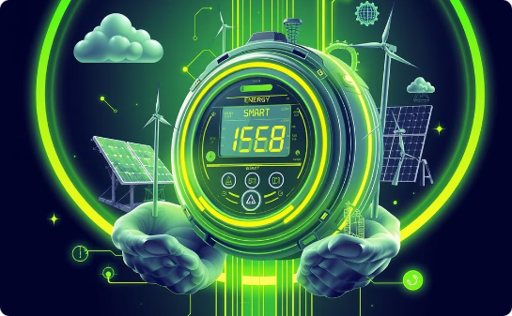
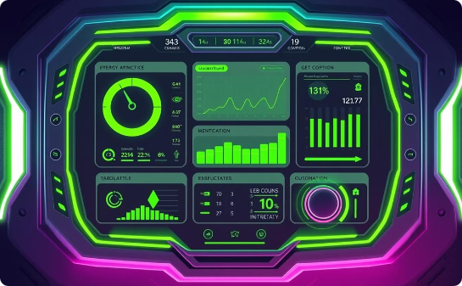
Future Prospects and Innovations
AI-Based Energy Usage Predictions
Renewable Energy Integration
Enhanced User Interface
Advanced machine learning models analyze historical data to forecast energy consumption patterns, enabling proactive management and optimization.
The smart energy meter will integrate with a variety of renewable energy sources, allowing for dynamic load balancing and increased reliance on clean power.
An improved user interface with personalized dashboards and advanced control options will empower consumers to take a more active role in managing their energy usage.
Notes:
20

Slide 22
Conclusion and Key Takeaways
1
Smarter Energy Management
2
Enhanced Safety and Reliability
The smart energy meter enables real-time monitoring and control, empowering users to make data-driven decisions to optimize energy consumption.
Robust overload protection, automatic power shutoff, and error detection features ensure the safe and reliable operation of the system.
3
Sustainable Energy Integration
4
Scalable and Versatile
The smart energy meter's modular design and cloud connectivity make it adaptable to a wide range of residential and commercial applications.
Seamless integration with renewable energy sources like solar and wind power promotes the adoption of clean energy solutions.
Notes:
21

Slide 23
References
PZEM-004T Datasheet - Technical specifications and operating parameters for the PZEM-004T energy monitoring module used in the smart meter design.
ThingSpeak IoT Analytics Platform - Documentation for setting up IoT data storage and visualization with ThingSpeak.
Chatgpt - Used for generating project documentation, technical guidance, and refining content related to the smart energy meter, including hardware/software integration and IoT implementation.
YOUTUBE - https://www.youtube.com/watch?v=h3_sOcrZwYw , https://www.youtube.com/watch?v=ca6copwwg8w, https://www.youtube.com/watch?v=j0_y8dPfpKc , https://www.youtube.com/watch?v=nS_h2XI8iSY
ESP32 Documentation - Comprehensive reference for programming and integrating ESP32 microcontrollers in IoT systems.
Notes:
22

Slide 24
References
Connecting ESP32 to ThingSpeak - How to publish data from ESP32 to ThingSpeak for monitoring and analytics.
ESP32 and PZEM Energy Monitoring System - A practical guide to building energy monitoring systems with PZEM and ESP32.
ThingSpeak IoT Data Visualization Tutorial - How to use ThingSpeak for collecting and visualizing IoT data.
0.96-inch OLED Display Guide - A detailed guide for wiring and coding OLED displays with microcontrollers.
Using Relays with ESP32 - A detailed explanation on relay operation and how to control them using ESP32.
Notes:
22

Slide 25
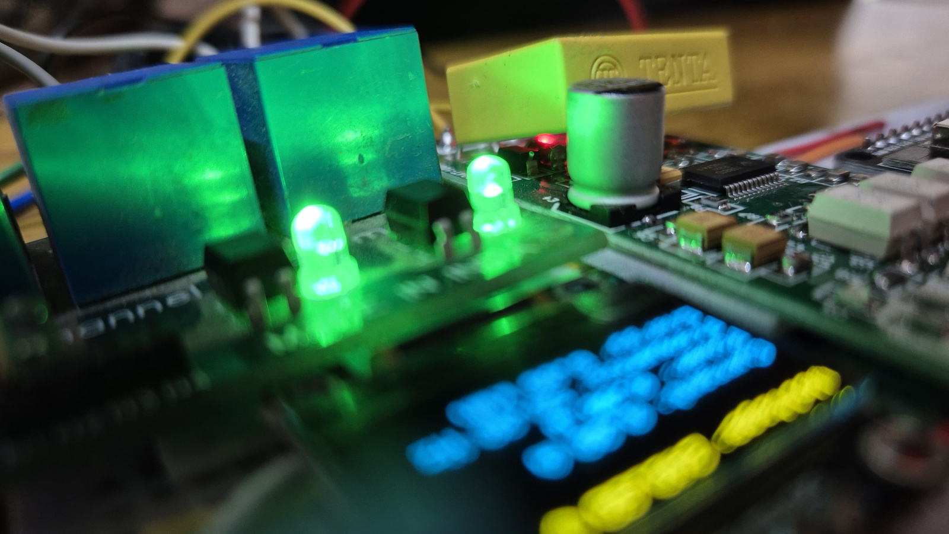
Questions and Feedback
We welcome your questions and feedback about the smart energy meter project. Please share your thoughts, concerns, or ideas for improvement. Your input is invaluable as we continue to refine and enhance this innovative energy management solution.
Notes:
23

